Slide 1
Lab 7 Message Queue and Shared Memory
TA: Gang-Yang
Professor: Hsung-Pin Chang
Operating System Lab

Slide 2
Outline
Message Queue
Overview
API
Exercises I
Shared Memory
Overview
API
Exercises II

Slide 3
Message Queue
Provide a reasonably easy and efficient way of passing data between two unrelated processes
Process A
Process B
Message Queue
message

Slide 4
Message Queue Structure in Linux
struct msqid_ds
struct msg
ipc_perm structure
(owner and permission)
*next
*next
type
type
*msg_first
*msg_last
message
message

Slide 5
Message Queue API
Main functions in the POSIX message queue API
mq_open(): creates a new message queue or opens an existing queue
mq_close(): closes a message queue
mq_unlink(): deletes a message queue
mq_send(): writes a message to a queue
mq_receive(): reads a message from a queue.

Slide 6
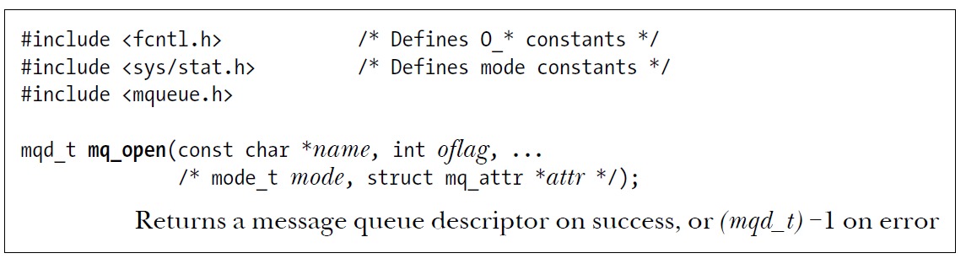
Opening a Message Queue
oflag: as shown in the next slide
mode: as shown in the following next slide
attr: attributes for the new message queue
Shown in the following next slide
mqd_t: returns a message queue descriptor, a value of type mqd_t
mqd_t is an int in Linux
Notes:
Mq open會有幾個參數 我們等等會講
然後mqd

Slide 7
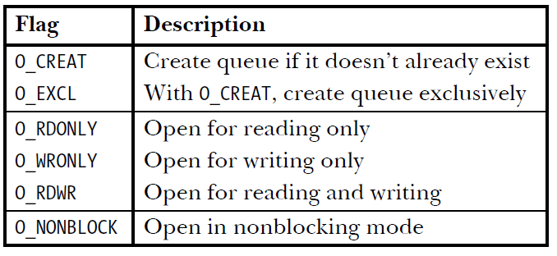
Bit values for the mq_open() oflag argument

Slide 8
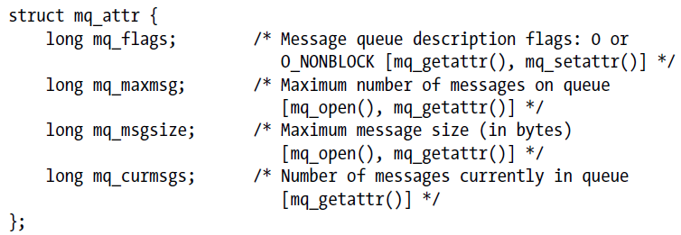
Message Queue Attributes
mq_open() only needs to specify two of the fields
mq_maxmsg and mq_msgsize
As shown in the comments

Slide 9
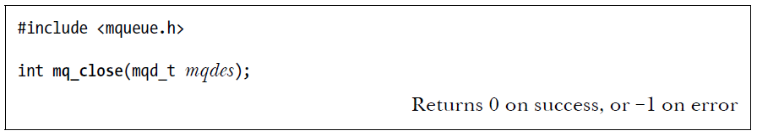
Closing a Message Queue
mq_close(): closes a message queue
mqd_t: returns a message queue descriptor
mqd_t is an integer in Linux
mq_close() doesn’t delete queue.

Slide 10
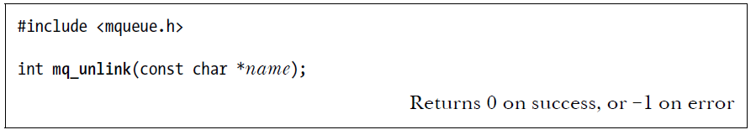
Removing (Deleting) a Message Queue
mq_unlink(): deletes a message queue
Removes the queue’s name
If O_CREAT flag is not set , thread can’t use the queue by name
Destroys the queue
Accurately if the reference count falls to zero, or
Postponed until all references to the message queue have been closed

Slide 11
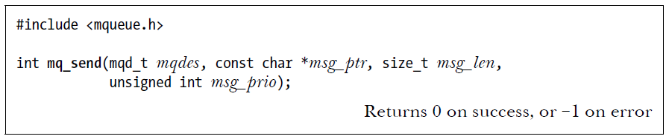
Sending Messages
mq_send(): writes a message to a queue
mqdes: descriptor referred to the message queue
msg_ptr: pointer points to the message
msg_len: the length of message pointed to by msg_ptr
msg_prio: NULL (Here, we ignore the message priority)

Slide 12
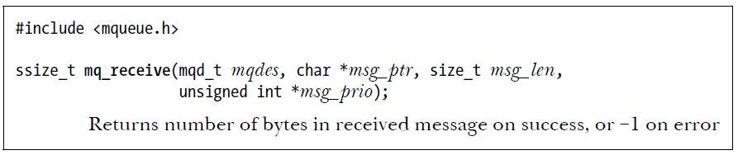
Receiving Messages
mq_receive(): reads a message from a queue.
msg_ptr: buffer pointed to by msg_ptr
msg_len: the number of bytes of space available in the buffer
hence, the size of buffer must be greater than or equal to the mq_msgsize of the queue
msg_prio: NULL (Here, we ignore the message priority)

Slide 13
Directory Structure
lab7 (資料夾)
example1 (資料夾)
sender.c
receiver.c
NCHU System & Network Lab

Slide 14
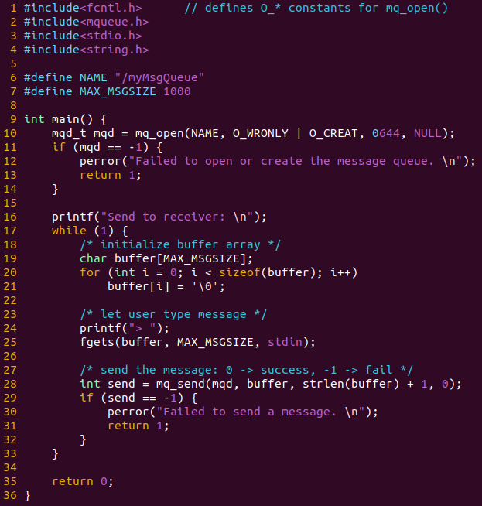
lab7/example1/sender.c

Slide 15
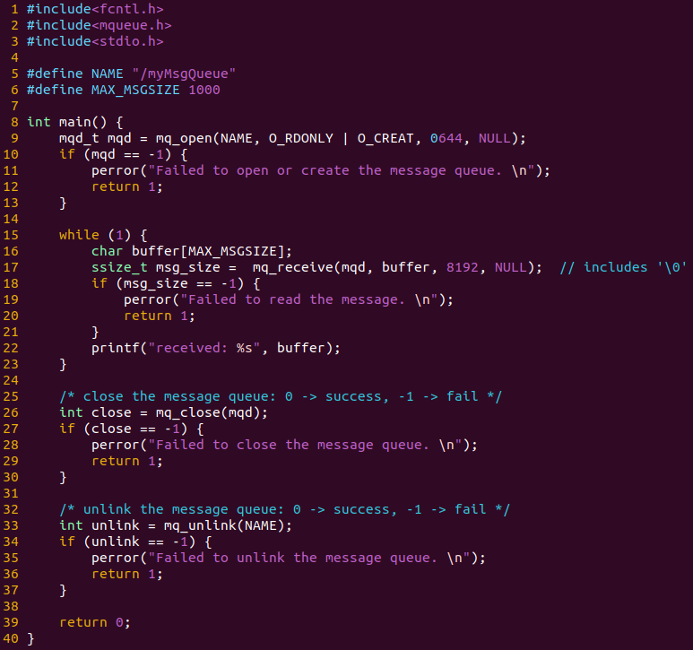
lab7/example1/ receiver.c

Slide 16
Directory Structure
lab7 (資料夾)
example1 (資料夾)
sender.c
receiver.c
exercise1 (資料夾)
sender.c
receiver.c
NCHU System & Network Lab

Slide 17
Exercise 1 (50 pts.)
Write two programs:
sender.c
create a message queue
user can iteratively type strings, until typing “exit”
send message to message queue
receiver.c
iteratively receive message from message queue
show the message on the screen
close & unlink the message queue

Slide 18
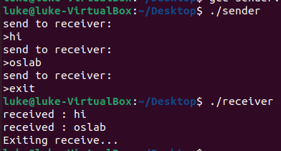
Exercise 1 Result

Slide 19
Appendix
You might use these functions:
- fgets(char *s, int n, FILE *stream)
Get string from *stream to *s with length n. Use stdin in *stream filed to get input from keyboard.
Ex: fgets(buf, BUFSIZ, stdin)
- strcmp(string str1, string str2)
Compare str1 and str2 .Return 0 if equal.
Ex: strcmp(message, “hello”)

Slide 20
Outline
Message Queue
Overview
API
Exercises I
Shared Memory
Overview
API
Exercises II

Slide 21
POSIX Shared Memory
Two techniques that allow unrelated
processes to share memory regions for IPCs
shared memory‐mapped file
Need to explicitly create a file
Shared memory
Without needing to create a corresponding mapped file

Slide 22
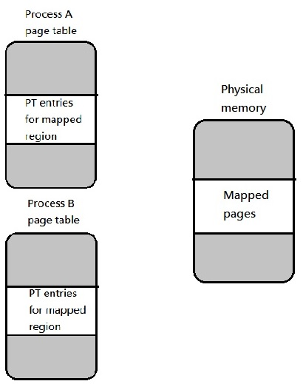
POSIX Shared Memory(cont.)

Slide 23
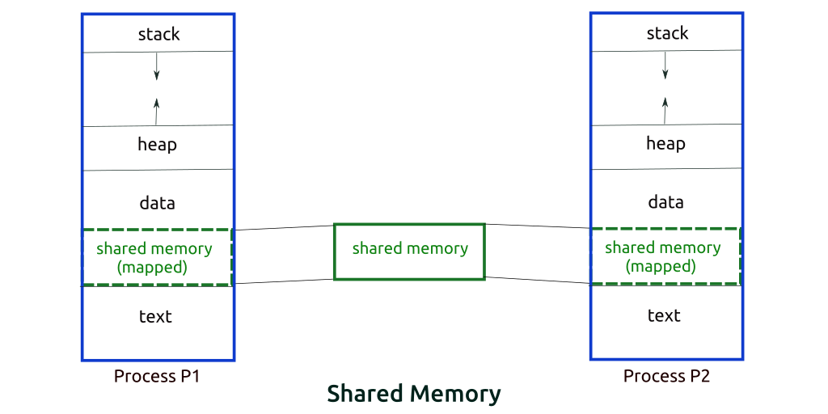
Locations of Shared Memory

Slide 24
POSIX Shared Memory(cont.)
To use a POSIX shared memory object
Use the shm_open() function to open or create an object with a specified name
Return a file descriptor referring to the object
Analogous to the open() system call
Pass the file descriptor in a call to mmap()
Specifies MAP_SHARED in the flags argument

Slide 25
POSIX Shared Memory(cont.)
Linux create a pseudo‐file for shared memory
objects in a special location /dev/shm
The shared memory has kernel persistence
The objects will persist even if no process currently has them open
Until the system is shut down or calling unlink()

Slide 26
POSIX Shared Memory(cont.)
Similar to the memory‐mapped files
Use a semaphore (or other synchronization primitive) to synchronize their accesses, if two or more processes access a memory‐mapped file simultaneously
Introduced later in Lab 12

Slide 27
POSIX API
Function | Description
shm_open() | Creates and opens a new shared memory object or opens an existing object.
ftruncate() | Set the size of a file to the value specified by length.
mmap() | Creates a new mapping in the calling process’s virtual address space.
munmap() | Removing a mapping from the calling process’s virtual address space.
shm_unlink() | Removes the shared memory object specified by name.

Slide 28
Creating Shared Memory Objects
shm_open()
#include<sys/mman.h>
int shm_open(const char *name, int oflag, mode_t mode);
EX: shm_open( NAME, O_RDWR, 0666 );
Returns file descriptor on success, or –1 on error
name : Identifies the shared memory object to be created or opened.
oflag : Mask of bits that modify the behavior of the call.
mode : File Permission

Slide 29
Bit values for the shm_open() oflag argument
Library fcntl.h
Flag | Description
O_CREAT O_EXCL | Create object if it doesn’t already exist With O_CREAT, create object exclusively
O_RDONLY O_RDWR | Open for read-only access Open for read-write access
O_TRUNC | Truncate object to zero length

Slide 30
Bit values for the shm_open() mode argument
Library sys/stat.h
Constants for File Permission Bits
Constant | Octal value | Permission bit
S_IRUSR S_IWUSR S_IXUSR | 0400 0200 0100 | User-read User-write User-execute
S_IRGRP S_IWGRP S_IXGRP | 040 020 010 | Group-read Group-write Group-execute
S_IROTH S_IWOTH S_IXOTH | 04 02 01 | Other-read Other-write Other-execute

Slide 31
Creating Shared Memory Objects (cont.)
mmap()
#include<sys/mman.h>
void *mmap(void *addr, size_t length, int prot, int flags,
int fd, off_t offset);
EX: mmap(NULL, 1024, PROT_WRITE, MAP_SHARED
shm_fd, 0);
Returns starting address of mapping on success,
or MAP_FAILED on error

Slide 32
Creating Shared Memory Objects (cont.)
mmap() (cont.)
void *mmap(void *addr, size_t length, int prot, int flags,
int fd, off_t offset);
addr : Indicates the virtual address at which the mapping is to be located.
length : Specifies the size of the mapping in bytes.
prot : A bit mask specifying the protection to be placed on the mapping.
flags : A bit mask of options controlling various aspects of the mapping operation.
fd : A file descriptor identifying the file to be mapped.
offset : Specifies the starting point of the mapping in the file.
Notes:
Prot 是指map到的這段記憶體 所開出去的權限

Slide 33
Memory protection values prot argument
Value | Description
PROT_READ | The contents of the region can be read
PROT_WRITE | The contents of the region can be modified
PROT_EXEC | The contents of the region can be executed
PROT_NONE | The region can not be accessed

Slide 34
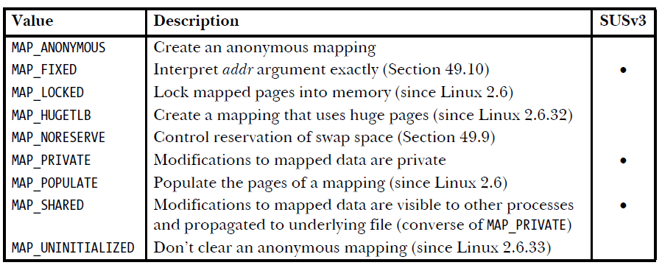
Bit-mask values for the mmap() flags argument

Slide 35
Creating Shared Memory Objects (cont.)
ftruncate()
#include<unistd.h>
int ftruncate(int fildes, off_t length);
EX: ftruncate( fd, 2048);
Return 0 on success, or –1 on error
fildes : File descriptor.
length : Size of the file.

Slide 36
Removing Shared Memory Objects
munmap()
#include< sys/mman.h>
int munmap(void *addr, size_t length);
EX: munmap( address, 2048);
Return 0 on success, or –1 on error
addr : The starting address of the address range to be unmapped.
length : The size (in bytes) of the region to be unmapped.

Slide 37
Removing Shared Memory Objects (cont.)
shm_unlink()
#include< sys/mman.h>
int shm_unlink(const char *name);
EX: shm_unlink( NAME );
Return 0 on success, or –1 on error
name : Identifies the shared memory object to be removed.

Slide 38
Directory Structure
lab7 (資料夾)
example1 (資料夾)
exercise1 (資料夾)
example2 (資料夾)
producer.c
comsumer.c
NCHU System & Network Lab

Slide 39
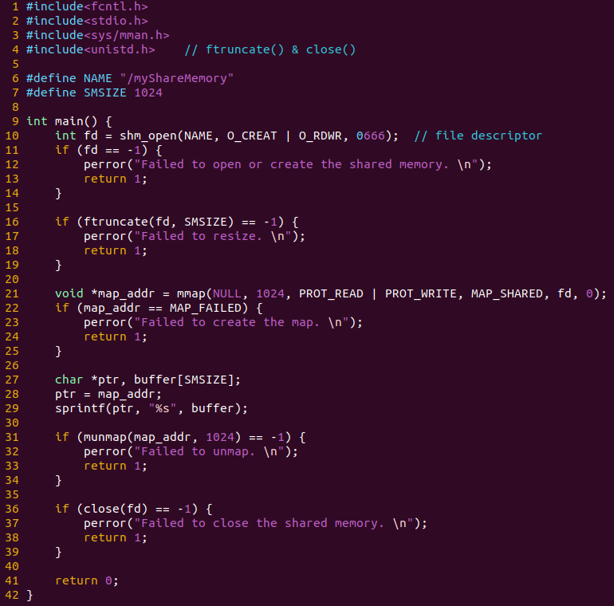
lab7/example2/producer.c

Slide 40
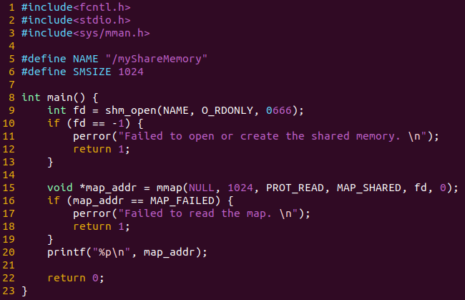
lab7/example2/consumer.c

Slide 41
Compiler & Linking
On Linux, programs employing the POSIX IPC mechanisms must be linked with the librt Library
Specifying the –lrt option to the gcc command.

Slide 42
Exercise 2 (50 pts.)
Write two programs:
producer.c
create a shared memory
user can type some message into the shared memory
consumer.c
print the context of shared memory on the screen

Slide 43
Directory Structure
lab7 (資料夾)
example1 (資料夾)
exercise1 (資料夾)
example2 (資料夾)
exercise2 (資料夾)
producer.c
comsumer.c
NCHU System & Network Lab

Slide 44

Exercise 2 Result

Slide 45
Reference
The Linux Tutorial
https://www.tutorialspoint.com/inter_process_communication/inter_process_communication_shared_memory.htm
https://www.tutorialspoint.com/inter_process_communication/inter_process_communication_message_queues.htm
The Linux Programmer’s Guide
http://tldp.org/LDP/lpg/

